Slide 1
"7 Key Lessons from 3 Decades: Unpacking Data Misalignment in Education" Dr. Janet Johnson

Slide 2
What is the Service Indicator Concept Map?
© 2008 EDSTAR, Raleigh-Durham, N.C.
All rights reserved.
copyright 2008 EDSTAR, Inc.
Notes:
2

Slide 3
Roadblocks to change
© 2008 EDSTAR, Inc.

Slide 4
Vocabulary Mix-Up
They report that they served low achieving students when instead they served low income students, most of whom were high achieving.
© 2008 EDSTAR, Inc.
Notes:
This may not have been obvious before, but as educators start to learn to use data this vocabulary mix-up has become more apparent.
As educators are making the transition to using data, and using programs designed to do specific things, such as bring students to grade level we are finding the key piece missing is often that they didn’t look at the appropriate data when they targeted the students for services.

Slide 5
Risk Factor Mix-Up
They believe most students with a demographic risk factor need an intervention, and most without a risk factor don’t.
© 2008 EDSTAR, Inc.
Notes:
We have also heard discussions and seen effects that illustrate that confusion exits about what is meant by “at risk” and risk factors.

Slide 6
Why is this straight A, well-behaved student in a dropout prevention program?
© 2007 Jupiterimages Corp.
© 2010 EDSTAR Analytics, Inc.
Notes:
Yet, this is who we keep finding in the dropout prevention programs.

Slide 7
Why is this Level IV gifted-in-math student receiving remedial math services in a dropout prevention program?
© 2010 EDSTAR Analytics, Inc.

Slide 8
Why is this gifted-in-reading A student being tutored in English in a dropout prevention program?
© 2008 EDSTAR, Inc.

Slide 9
Unclear?

Slide 10
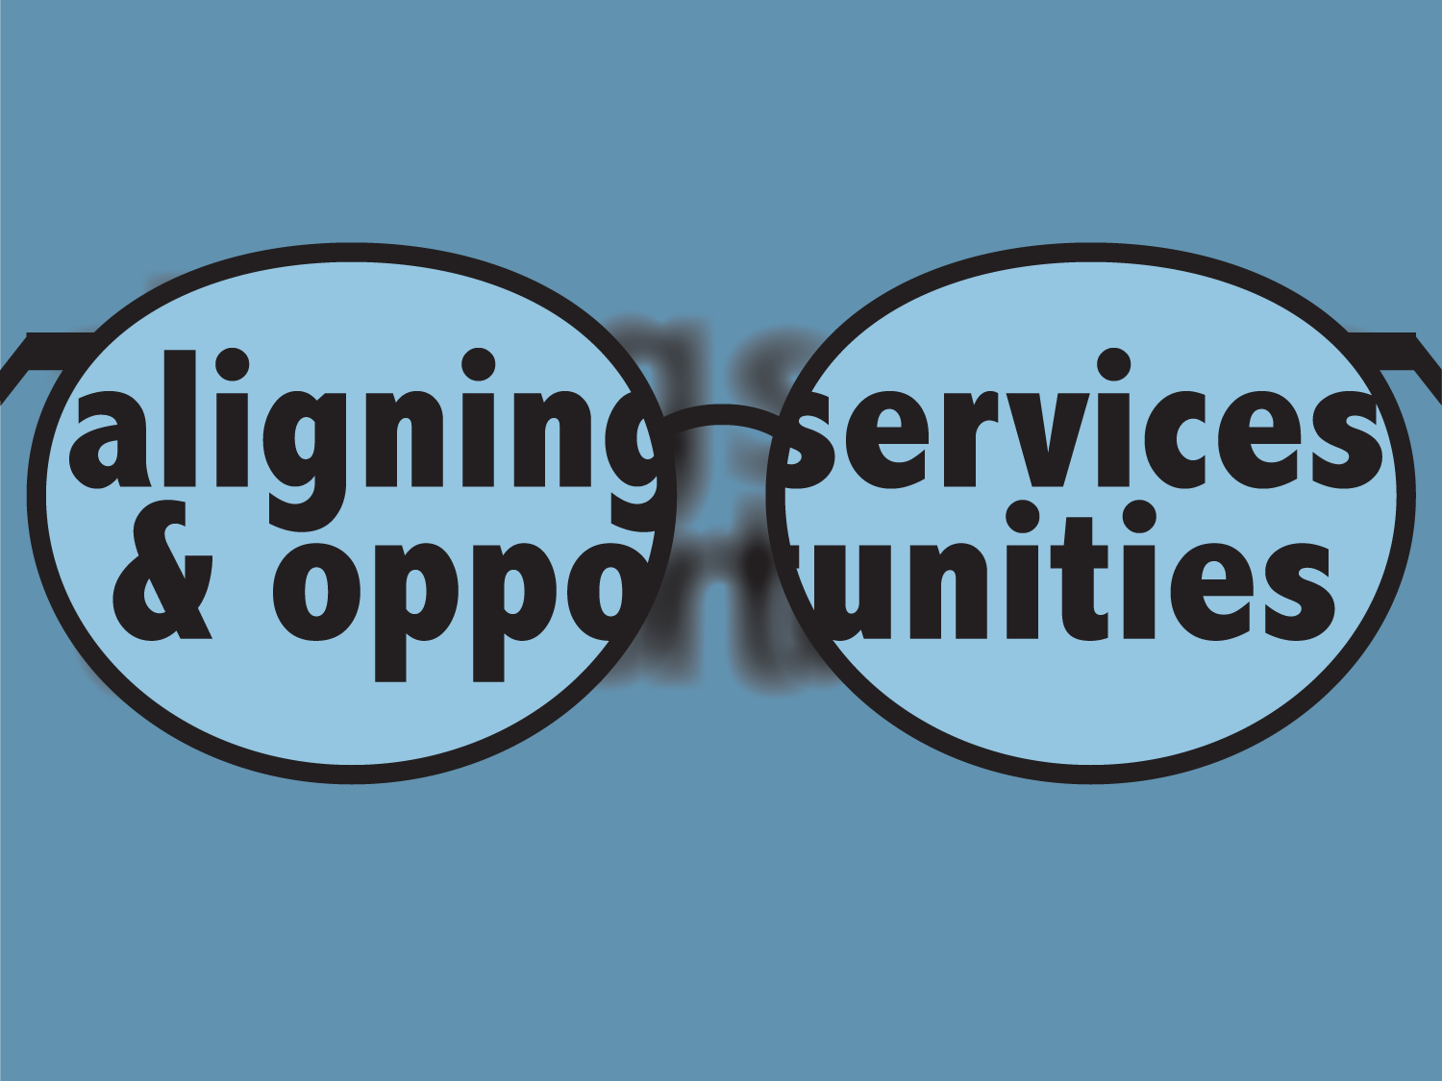
Data Sharpens the Focus!

Slide 11
What’s the relationship between educators and student achievement in the at-risk model?
© 2008 EDSTAR, Inc.

Slide 12
Key components affecting our ability to educate
© 2008 EDSTAR, Inc.

Slide 13
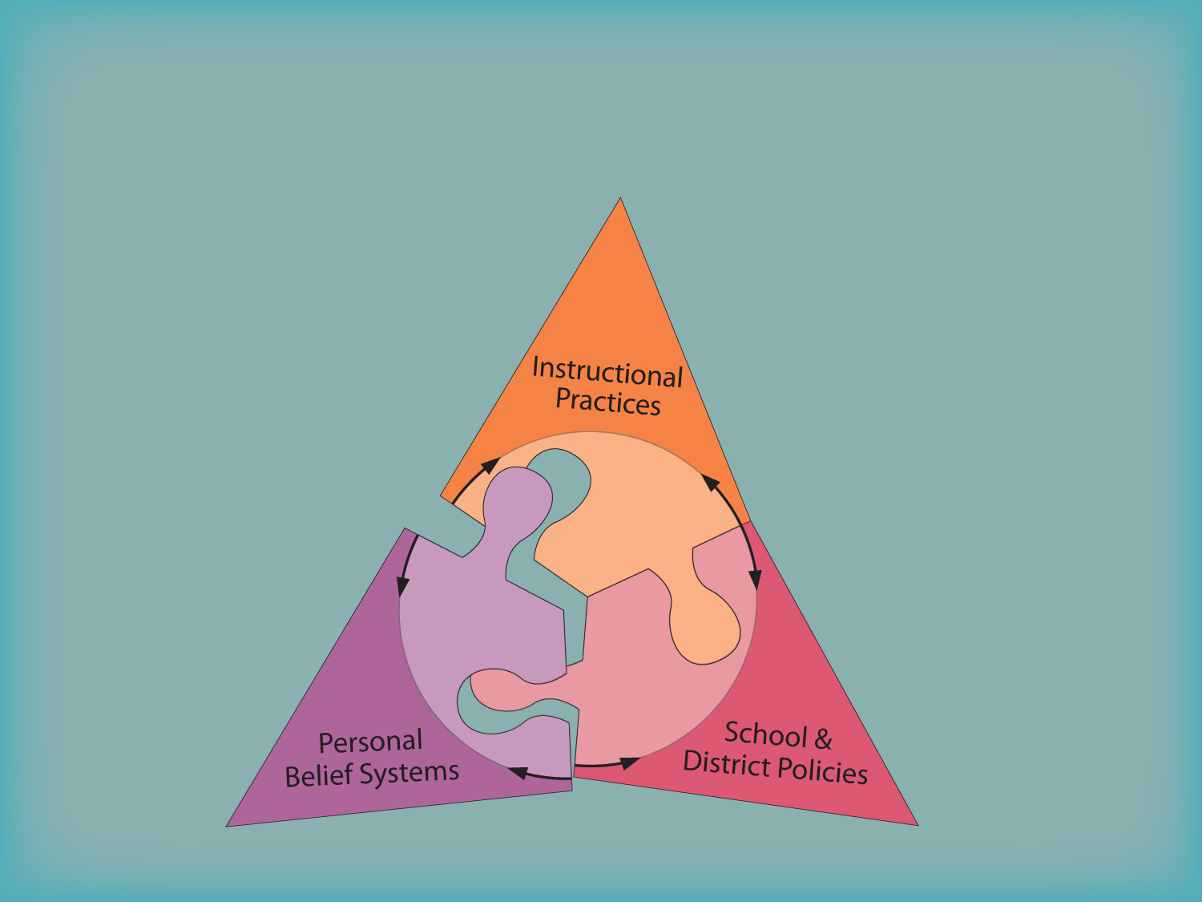
They are interdependent
© 2008 EDSTAR, Inc.

Slide 14
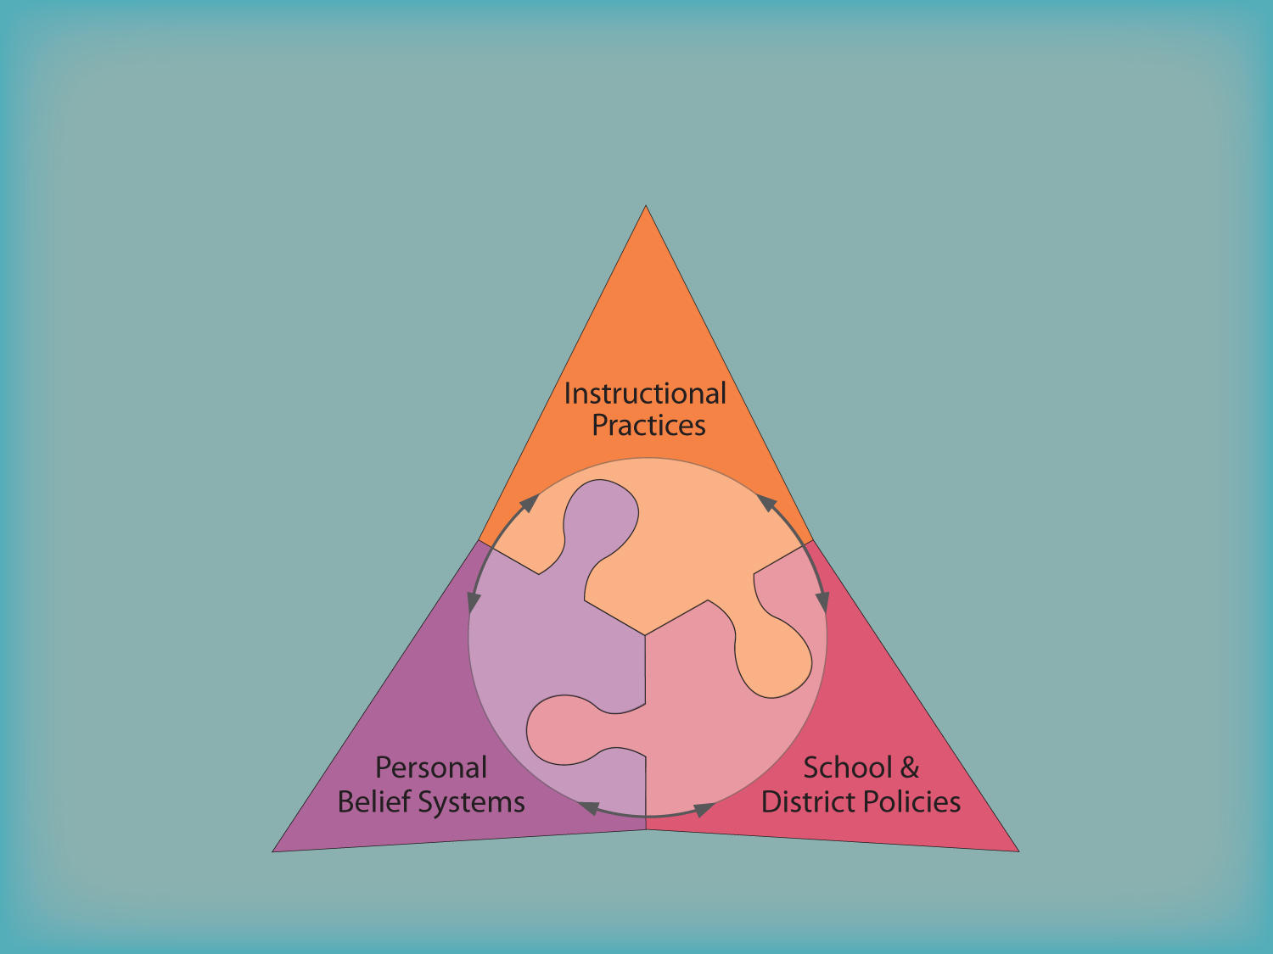
This is a stable base for learning
© 2008 EDSTAR, Inc.

Slide 15
Student Achievement is supported
© 2008 EDSTAR, Inc.

Slide 16
Kinds of Data
© 2013 EDSTAR, Inc.

Slide 17
It Ain’t the Kidz!

Slide 18
It’s Us!
© 2009 EDSTAR, Inc.

Slide 19
Roadblocks to change
© 2008 EDSTAR, Inc.

Slide 20
Unclear?

Slide 21
Data Sharpens the Focus!

Slide 22
"7 Key Lessons from 3 Decades: Unpacking Data Misalignment in Education"
Misalignment of service provision and student need is persistent.
Reliance on demographic data can lead to erroneous identification of 'at-risk' students.
High-scoring students often miss out on advanced courses due to misidentification.
The majority of dropout prevention program participants may not fit the 'at-risk' profile.
Resistance to data-based student identification can hinder progress.
Legislation alone cannot correct the misalignment in education.
Effective use of data is critical for ensuring equity and diversity in education.

